Slide 1

Unit: 3
Protection and Multitasking
Mr. Sumit Shinde
Assistant Professor
Computer Engineering Department
Pune Institute of Computer Technology

Slide 2
Need of Protection
Problem may occur in a multitasking OS or multi user systems when two or more users attempt to read and change the content of a memory location at the same time – The section of program must be protected by other task until the operation must be complete.
Protection which isolate and protect user programs from each other and the operating system.

Slide 3
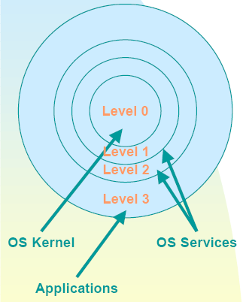
Privilege Levels
Highest
00: Highest Privilege
01
10
11: Lowest Privilege
Lowest

Slide 4
Privilege levels
The need is to prevent
  Users from interfering with one another
  Users from examining secure data
  Program bugs from damaging other programs
  Program bugs from damaging data
  Malicious attempts to compromise system integrity
  Accidental damage to data

Slide 5
Privilege Protection
Continuous checking by the processor on whether the application is privileged enough to
  Type 1: Execute certain instructions
  Type 2: Reference data other than its own
  Type 3: Transfer control to code other than its own
To manage this every segment has a privilege level called the DPL (Descriptor Privilege Level) Bits 45,46

Slide 6
Descriptor Privilege Level
Privilege levels apply to entire segments
The privilege level is defined in the segment descriptor
The privilege level of the code segment determines the Current Privilege Level (CPL)

Slide 7
Type 1: Privilege Checking
Privileged Instructions
  Segmentation and Protection Based (HLT, CLTS, LGDT, LIDT, LLDT, LTR, moving data to Control, Debug and Test registers)
  Interrupt flag based (CLI, STI, IN, INS, OUT, OUTS)
  Peripheral IO based
First two types of privileged instructions can be executed only when CPL = 0, that is, these instructions can be in code segment with DPL = 0.

Slide 8
I/O instructions
The I/O based privileged instructions are executed only if CPL <= IOPL in EFLAGS register.
To add to the security the POPF/POPFD instructions which load values into the EFLAGS shall not touch the IOPL bit or IF bit if CPL > 0.

Slide 9
Type 2: Privilege Checking
Reference data other than its own
Load a selector into a DS, ES, FS and GS if max(RPL,CPL) <= DPL
  RPL may weaken your privilege level
Load a descriptor into a stack if DPL = CPL

Slide 10
Type 3: Privilege Checking
Transfer control to code other than its own. Essentially load a new selector into CS register
jmp across code segments with same DPL
  jmp <selector>:<offset of instruction from start of the new segment>
  call <selector>:<offset of instruction from start of the new segment>

Slide 11
Changing Privilege levels
Control transfer from a code of some PL to another code with some other different PL.
Using conforming code segments or a special segment descriptor called call gates.
Conforming code segments confirms with the privilege level of the calling code. So if a control transfer happens from segment S to a confirming segment T, the privilege of T would be the privilege of S.

Slide 12
Conforming Code Segment
The DPL of conforming code segment descriptor <= CPL of invoking code.
Therefore, CPL = 2 can invoke DPL = 1.
CPL = 2 cannot invoke code with DPL = 3.
Why?
  If not, you JMP back or RET to the source code segment after executing the conforming code segment. This should permit return from a numerically low privilege code to a numerically high privilege code, without check.

Slide 13
CALL GATE descriptor
Is defined by a system descriptor (S=0) in GDT which is used by the JMP or CALL.
The 64-bit descriptor in GDT
Destination Offset
15-0
Destination offset
31-16
01100
000
WC
Destination Selector (16 bits)
P, DPL
Not only the selector for the target code segment, but also the offset in the code segment from which you should start executing is specified. The source code segment can only use it like a black-box

Slide 14
Calling Higher privileged code
Code Seg
Code Seg
Code Desc
CALL
SEG
OFFSET
CALL
SEG
OFFSET
Gate – Sel + offset
Code Desc
Correct
Incorrect

Slide 15
Call Gates
Are defined like segment descriptors
Occupy a slot in the descriptor tables
Provide the only means to alter the current privilege level
Define entry points to other privilege levels
Must be invoked using a CALL Instruction

Slide 16
Call Gate accessibility
Target DPL <= Max (RPL, CPL) <= Gate DPL
For eg. CPL = 2 and the target PL = 0, you should use a Gate with PL = 2 or 3

Slide 17
Privilege levels and Stacks
The stack PL = CPL always
When changing the CPL, the processor automatically changes the stack!!!
How – using the Task State Segment (TSS)
The base of the TSS is stored in a Task register (TR) which is updated by the privileged instruction LTR
The TSS associates a stack for each code for each of the privilege levels 0, 1 and 2

Slide 18
Privileged Instructions
HLT -- Halt
Operation
Enter Halt state;
Description
HALT stops instruction execution and places the 80386 in a HALT state. An enabled interrupt, NMI, or a reset will resume execution. If an interrupt (including NMI) is used to resume execution after HLT, the saved CS:IP (or CS:EIP) value points to the instruction following HLT.
Flags Affected
None

Slide 19
CLTS -- Clear Task-Switched Flag in CR0
Operation
TS Flag in CR0 <- 0;
Description
CLTS clears the task-switched (TS) flag in register CR0. This flag is set by the 80386 every time a task switch occurs. The TS flag is used to manage processor extensions as follows:
- Every execution of an ESC instruction is trapped if the TS flag is set. - Execution of a WAIT instruction is trapped if the MP flag and the TS flag are both set. Thus, if a task switch was made after an ESC instruction was begun, the processor extension's context may need to be saved before a new ESC instruction can be issued. The fault handler saves the context and resets the TS flag.
Flags Affected
TS = 0 (TS is in CR0, not the flag register)

Slide 20
LGDT/LIDT -- Load Global/Interrupt Descriptor Table Register
Description The LGDT and LIDT instructions load a linear base address and limit value from a six-byte data operand in memory into the GDTR or IDTR, respectively. If a 16-bit operand is used with LGDT or LIDT, the register is loaded with a 16-bit limit and a 24-bit base, and the high-order eight bits of the six-byte data operand are not used. If a 32-bit operand is used, a 16-bit limit and a 32-bit base is loaded; the high-order eight bits of the six-byte operand are used as high-order base address bits.
Flags Affected
None

Slide 21
LLDT -- Load Local Descriptor Table Register
Description
LLDT loads the Local Descriptor Table register (LDTR). The word operand (memory or register) to LLDT should contain a selector to the Global Descriptor Table (GDT). The GDT entry should be a Local Descriptor Table. If so, then the LDTR is loaded from the entry. The descriptor registers DS, ES, SS, FS, GS, and CS are not affected. The LDT field in the task state segment does not change.
The selector operand can be 0; if so, the LDTR is marked invalid. All descriptor references cause a #GP fault.
Flags Affected
None

Slide 22
LTR -- Load Task Register
Description
LTR loads the task register from the source register or memory location specified by the operand. The loaded task state segment is marked busy. A task switch does not occur.
LTR is used only in operating system software; it is not used in application programs.
Flags Affected
None

Slide 23
LMSW -- Load Machine Status Word
Description
LMSW loads the machine status word (part of CR0) from the source operand. This instruction can be used to switch to Protected Mode; if so, it must be followed by an intra-segment jump to flush the instruction queue. LMSW will not switch back to Real Address Mode.
Flags Affected
None

Slide 24
MOV CR_{n} , REG / MOV REG , CR_{n}
Description
The above forms of MOV store or load Control registers CR0, CR2, and CR3 in or from a general purpose register
32-bit operands are always used with these instructions, regardless of the operand-size attribute
Flags Affected
OF, SF, ZF, AF, PF, and CF are undefined

Slide 25
MOV DR_{n} , REG / MOV REG , DR_{n}
Description
The above forms of MOV store or load Control registers Debug Registers DR0, DR1, DR2, DR3, DR6, and DR7 in or from a general purpose register
32-bit operands are always used with these instructions, regardless of the operand-size attribute
Flags Affected
OF, SF, ZF, AF, PF, and CF are undefined

Slide 26
MOV TR_{n} , REG / MOV REG , TR_{n}
The above forms of MOV store or load Control registers Test Registers TR6 and TR7 in or from a general purpose register
32-bit operands are always used with these instructions, regardless of the operand-size attribute
Flags Affected
OF, SF, ZF, AF, PF, and CF are undefined

Slide 27
IOPL Sensitive Instructions
IF CPL <= IOPL then only these instructions will be executed
The instructions are :
CLI -- Clear Interrupt Flag
STI -- Set Interrupt Flag
IN -- Input from Port
INS/INSB/INSW/INSD -- Input from Port to String
OUT -- Output to Port
OUTS/OUTSB/OUTSW/OUTSD -- Output String to Port

Slide 28
CLI -- Clear Interrupt Flag
Description
CLI clears the interrupt flag if the current privilege level is at least as privileged as IOPL. No other flags are affected. External interrupts are not recognized at the end of the CLI instruction or from that point on until the interrupt flag is set.
Flags Affected
IF = 0

Slide 29
STI -- Set Interrupt Flag
Description
STI sets the interrupt flag to 1. The 80386 then responds to external interrupts after executing the next instruction if the next instruction allows the interrupt flag to remain enabled. If external interrupts are disabled and you code STI, RET (such as at the end of a subroutine), the RET is allowed to execute before external interrupts are recognized. Also, if external interrupts are disabled and you code STI, CLI, then external interrupts are not recognized because the CLI instruction clears the interrupt flag during its execution.
Flags Affected
IF = 1

Slide 30
IN -- Input from Port
Description
IN transfers a data byte or data word from the port numbered by the second operand into the register (AL, AX, or EAX) specified by the first operand. Access any port from 0 to 65535 by placing the port number in the DX register and using an IN instruction with DX as the second parameter. These I/O instructions can be shortened by using an 8-bit port I/O in the instruction. The upper eight bits of the port address will be 0 when 8-bit port I/O is used.
Flags Affected
None

Slide 31
INS/INSB/INSW/INSD -- Input from Port to String
Description
INS transfers data from the input port numbered by the DX register to the memory byte or word at ES:dest-index. The memory operand must be addressable from ES; no segment override is possible. The destination register is DI if the address-size attribute of the instruction is 16 bits, or EDI if the address-size attribute is 32 bits.
INS does not allow the specification of the port number as an immediate value. The port must be addressed through the DX register value. Load the correct value into DX before executing the INS instruction.
The destination address is determined by the contents of the destination index register. Load the correct index into the destination index register before executing INS.
After the transfer is made, DI or EDI advances automatically. If the direction flag is 0 (CLD was executed), DI or EDI increments; if the direction flag is 1 (STD was executed), DI or EDI decrements. DI increments or decrements by 1 if a byte is input, by 2 if a word is input, or by 4 if a double word is input.
INSB, INSW and INSD are synonyms of the byte, word, and double word INS instructions. INS can be preceded by the REP prefix for block input of CX bytes or words. Refer to the REP instruction for details of this operation.
Flags Affected
None

Slide 32
OUT -- Output to Port
Description
OUT transfers a data byte or data word from the register (AL, AX, or EAX) given as the second operand to the output port numbered by the first operand. Output to any port from 0 to 65535 is performed by placing the port number in the DX register and then using an OUT instruction with DX as the first operand. If the instruction contains an eight-bit port ID, that value is zero-extended to 16 bits.
Flags Affected
None

Slide 33
OUTS/OUTSB/OUTSW/OUTSD -- Output String to Port
Description
OUTS transfers data from the memory byte, word, or double word at the source-index register to the output port addressed by the DX register. If the address-size attribute for this instruction is 16 bits, SI is used for the source-index register; otherwise, the address-size attribute is 32 bits, and ESI is used for the source-index register.
OUTS does not allow specification of the port number as an immediate value. The port must be addressed through the DX register value. Load the correct value into DX before executing the OUTS instruction.
The address of the source data is determined by the contents of source-index register. Load the correct index value into SI or ESI before executing the OUTS instruction.
After the transfer, source-index register is advanced automatically. If the direction flag is 0 (CLD was executed), the source-index register is incremented; if the direction flag is 1 (STD was executed), it is decremented. The amount of the increment or decrement is 1 if a byte is output, 2 if a word is output, or 4 if a double word is output.
OUTSB, OUTSW, and OUTSD are synonyms for the byte, word, and double word OUTS instructions. OUTS can be preceded by the REP prefix for block output of CX bytes or words. Refer to the REP instruction for details on this operation.
Flags Affected
None

Slide 34
Need of Protection,
Overview of 80386DX Protection
80386 DX has four levels of protection which isolate and protect user programs from each other and the operating system.
Uses 1) Segment Level Protection and 2) Page level Protection mechanism
Before memory cycle, each memory reference is checked by the hardware to verify that it satisfies the protection criteria

Slide 35
Segment Level Protection
Has five aspects
  Type Checking
  Limit Checking
  Restriction of addressable domain
  Restriction of procedure entry point
  Restriction of Instruction Set.

Slide 36
Segment Level Protection
Type Checking:
  Type field of the descriptor specifies
    Type of descriptor (system/non-system)
    Intended usage of the segment. Ex. If the segment is read only segment then its accessed is limited to only reading purpose

Slide 37
Segment Level Protection
Limit Checking:
  To prevent program from addressing outside the segments.
  It interprets limit field depending on the setting of the G (granularity) bit, which specifies whether limit value counts 1 byte or 4 Kb.
  The 80386DX causes a general protection exception when program attempts to
    Access memory byte at an address > limit
    Access memory word at an address>= limit
    Access memory dword at address>= (limit-2)

Slide 38
Privilege Level Protection
The privilege levels (PL) are numbered 0 through 3.
Level 0 is the most privileged or trusted level.

Slide 39
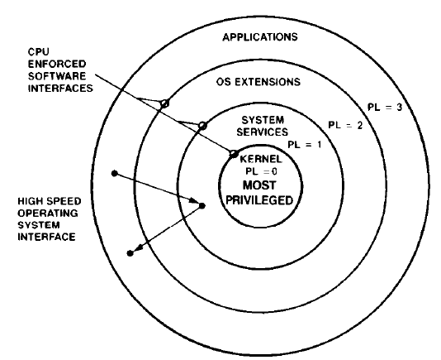
Privilege Level

Slide 40
Rules for Privileges
Intel 80386DX controls access to both data and procedures according to the following rules:
  (1) Data segment with privilege level p can be accessed only by the code executing at a privilege level atleast as privileged as p
  (E.g. Application programs are prevented from reading or changing OS Tables)

Slide 41
Rules for Privileges
(2) A code segment with a privilege level p can only be called by a task executing at the same or lesser privilege level than p
  (E.g. An Application Program may call an OS routine)

Slide 42
Privilege Level
There are 3 different types of privilege level entering into the privilege level checks:
  Current Privilege Level (CPL)
  Descriptor Privilege Level (DPL)
  Requestor Privilege Level (RPL)

Slide 43
Current Privilege Level (CPL)
CPL is stored in the selector of currently executing CS register
It represents the privilege level(PL) of the currently executing task.
It is also PL in the descriptor of the code segment.
It is also designated as Task Privilege Level(TPL)

Slide 44
Descriptor Privilege Level (DPL)
It is the PL of the object which is being attempted to be accessed by the current task
It is PL of target segment and is contained in the descriptor of the segment

Slide 45
Requestor Privilege Level (RPL)
It is the lowest two bits of any selector.
It can be used to weaken the CPL if desired.
The Effective Privilege Level(EPL) is
EPL = max (CPL,RPL) (here numbers)
Thus the task becomes less privileged.

Slide 46
Restricting Access to Data
Assume that a task needs data from data segment.
The privilege levels are checked at the time a selector for the target segment is loaded into the data segment register.
Three privilege levels enter into privilege checking mechanism
  CPL
  RPL of the selector of target segment
  DPL of the descriptor of the target segment

Slide 47
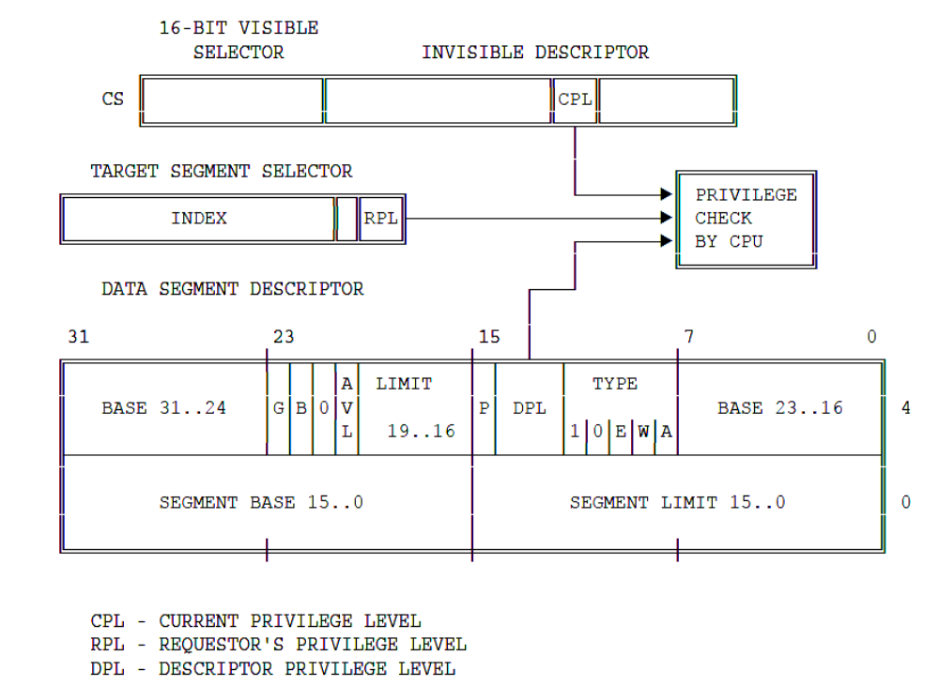
Restricting Access to Data
Access is allowed only if
DPL ≥ max (CPL,RPL)

Slide 48
Restricting Access to Data
A procedure can only access the data that is at the same or less privilege level (not numerically)

Slide 49
Restricting Control Transfer
Control transfer (except interrupts) are accomplished by JMP, CALL and RET instructions.
The near forms of JMP and CALL transfer within current code segment and requires only limit checking
The far forms of JMP and CALL refer to other segments and require privilege checking.

Slide 50
Restricting Control Transfer
The far JMP and CALL can be done in 2 ways:
Without Call Gate Descriptor
With Call Gate Descriptor

Slide 51
Without Call Gate
The processor permits a JMP or CALL directly to another segment only if
DPL of the target segment = CPL of the calling segment
Conforming bit of the target code is set and DPL of the target segment ≤ CPL
Conforming Segment: These segments may be called from various privilege levels but execute at the privilege level of the calling procedure. (e.g. math library)

Slide 52
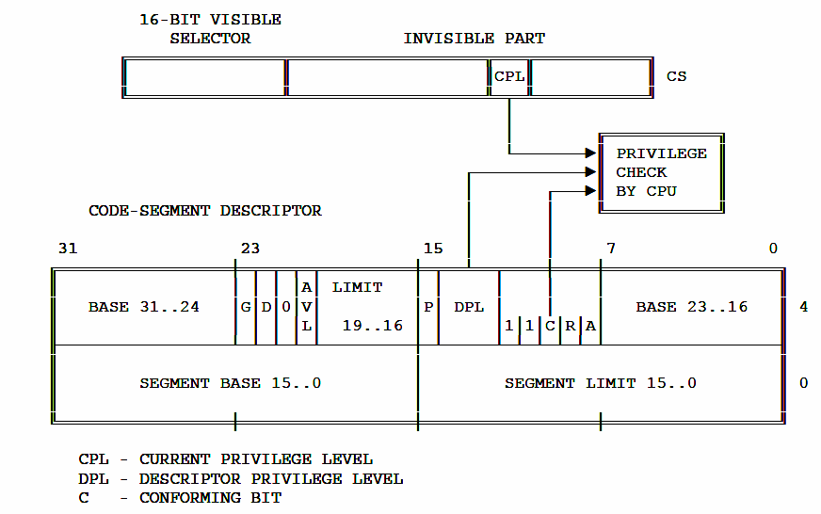
Privilege Check for Control Transfer without gate

Slide 53
With Call Gate
The far pointer of the control transfer instruction uses the selector part of the pointer and selects a gate.
The selector and offset fields of a gate form a pointer to the entry of a procedure.

Slide 54
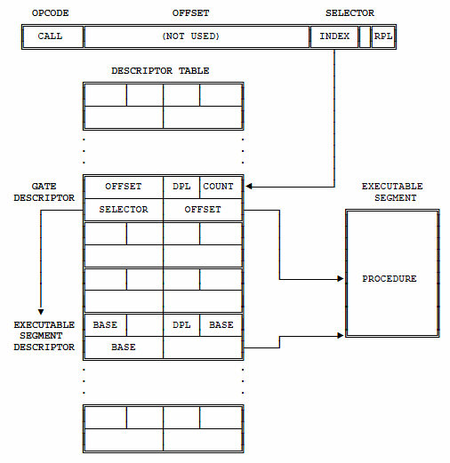
With Call Gate

Slide 55
With Call Gate
Four privilege levels are used to check the validity of the control transfer via a call gate:
CPL
RPL of the selector used to specify call gate
DPL of the gate descriptor
DPL of the descriptor of target segment.
Only CALL instruction can use gates to transfer to smaller privilege levels.

Slide 56
With Call Gate
For a JMP instruction, the privilege rules are
MAX(CPL,RPL) ≤ gate DPL
target segment DPL = CPL(numerically)
For a CALL instruction, the rules are
MAX(CPL,RPL) ≤ gate DPL
target segment DPL ≤ CPL(numerically)

Slide 57
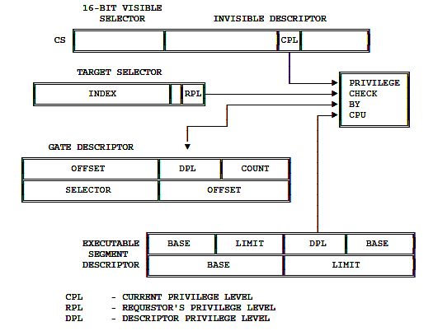
Privilege Check via Call Gate

Slide 58
MULTITASKING

Slide 59
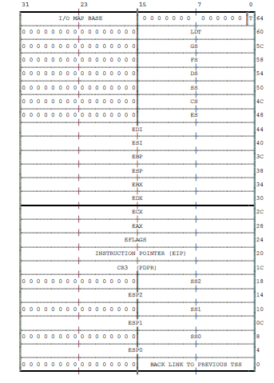
TSS

Slide 60
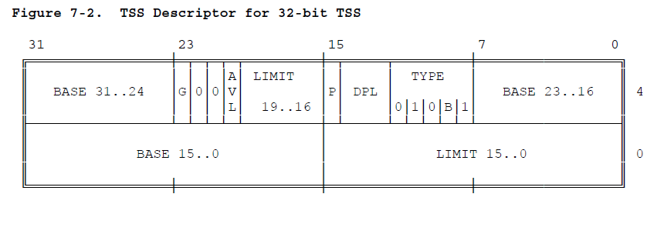
TSS Descriptor

Slide 61
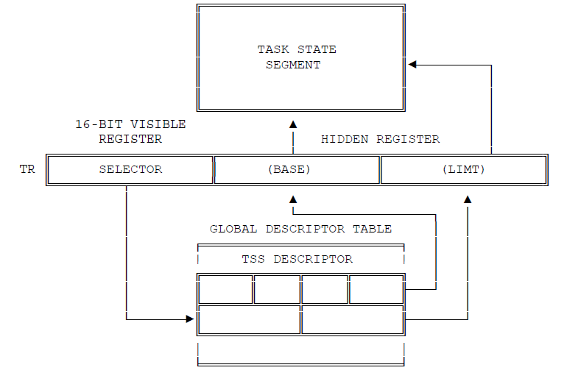
TASK Register

Slide 62
TASK Register Instructions
LTR (Load task register)
loads the visible portion of the task register.
loads the invisible portion with information from the TSS descriptor selected by the operand.
LTR is a privileged instruction; it may be executed only when CPL is zero.
LTR is generally used during system initialization to give an initial value to the task register; thereafter, the contents of TR are changed by task switch operations.
STR (Store task register) stores the visible portion of the task register in a general register or memory word. STR is not privileged.

Slide 63
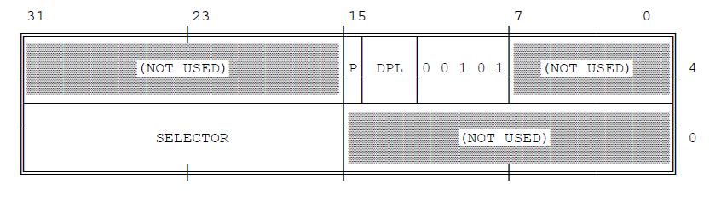
TASK GATE Descriptor

Slide 64
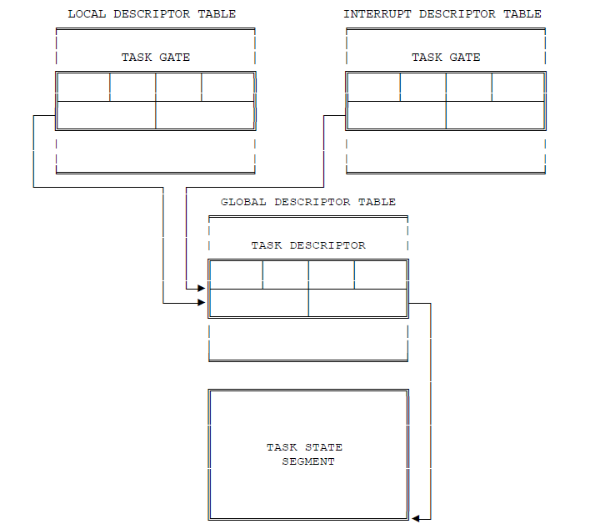

Slide 65
TASK GATE Descriptor
Condition to access gate: maximum of the selector's RPL and the CPL of the procedure is numerically less than or equal to the DPL of the descriptor.
Note: when a task gate is used, the DPL of the target TSS descriptor is not used for privilege checking.
several task gates that select the single TSS descriptor.
The need to provide selective access to tasks.
The need for an interrupt or exception to cause a task switch.

Slide 66
TASK Switching
Checking that the current task is allowed to switch to the designated task.
DPL of TSS Decsriptor<= max(RPL of gate, CPL)
Checking that the TSS descriptor of the new task is marked present and has a valid limit.
Saving the state of the current task.
Loading the task register with the selector of the incoming task's TSS descriptor, marking the incoming task's TSS descriptor as busy, and setting the TS (task switched) bit of the MSW.
Loading the incoming task's state from its TSS and resuming execution.

Slide 67
Note It…..
Every task switch sets the TS (task switched) bit in the MSW (machine status word).
The new task begins executing at the privilege level indicated by the RPL of the CS selector value that is loaded from the TSS.

Slide 68
TASK Linking
The back-link field of the TSS and the NT (nested task) bit of the flag word together allow the 80386 to automatically return to a task that CALLed another task or was interrupted by another task.
The NT flag indicates whether the back-link field is valid.
If NT is set, the 80386 switches back to the task selected by the back-link field.

Slide 69
Busy Bit (Prevents Loop)
When switching to a task, the processor automatically sets the busy bit of the new task.
When switching from a task, the processor automatically clears the busy bit of the old task if that task is not to be placed on the back-link chain , If the task is placed on the back-link chain, its busy bit remains set.
When switching to a task, the processor signals an exception if the busy bit of the new task is already set.

Slide 70
TASK Address Space
The LDT selector and PDBR fields of the TSS give software systems designers flexibility in utilization of segment and page mapping features of the 80386.
Task Linear-to-Physical Space Mapping

Slide 71
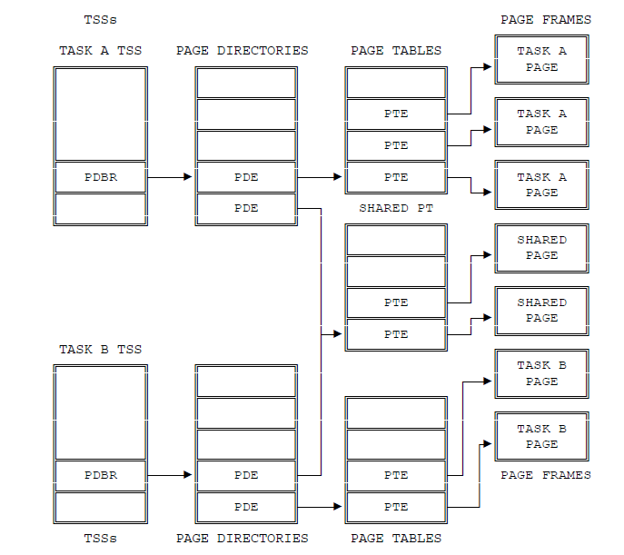

Slide 72
Task Logical Address Space
To share data, tasks must also have a common logical-to-linear space mapping; i.e., they must also have access to descriptors that point into a shared linear address space.
Via the GDT.
By sharing LDTs. Two or more tasks can use the same LDT if the LDT selectors in their TSSs select the same LDT segment.
By descriptor aliases in LDTs.

Slide 73
Best Luck!!

